Slide 1
Partial differential equations, PDE
Lecture 10
Heat equation - second example: laterally insulated and insulated ends of the bar
Heat equation – two dimensional

Slide 2
Partial differential equations
Definition: PDE
A PDE is an equation that contains one or more partial derivatives of an unknown function u that depends on at least two variables
Ex.:
Wave equation a model for the vibrating string
Ex.:
Heat equation a model for temperature in a bar or a wire

Slide 3
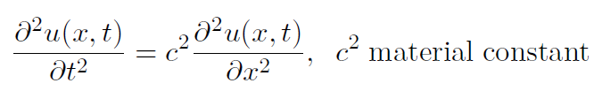


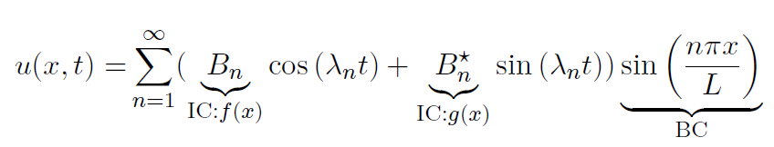

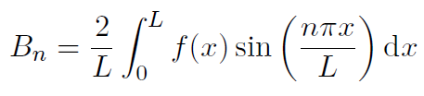

Previous lecture - vibrating string
The wave equation - one-dimensional homogeneous:
Boundary conditions:
Initial conditions:
The unique solution:
where:
and Fourier coefficients:

Slide 4



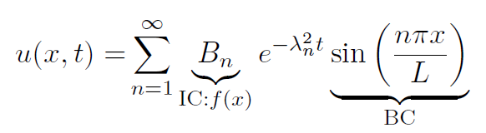

Previous lecture – thin bar laterally insulated
The heat equation - one-dimensional homogeneous:
Boundary conditions:
zero temperature at the ends for all times t
Initial conditions:
initial temperature profile at t = 0
The unique solution:
where:
and Fourier coefficients:

Slide 5
Today
Heat equation - second example: laterally insulated and insulated ends of the bar
Heat equation – two dimensional

Slide 6

Modelling
Consider a thin bar of length L along the x–axis that is laterally insulated
i.e. the heat can only ﬂow in the x–direction
J. Schmiegel: Lecture notes
The ends of the bar are also insulated for all times t
The initial temperature profile

Slide 7

Modelling
We want a simple and realistic mathematical model to de scribe our experiment
Therefore we introduce some physicals assumption:
Heat flow is proportional to gradient of temperature u(x, t)
The ends are insulated so no heat flow at the ends
i.e. the gradient of u(x, t) is zero at the ends
i.e. new boundary conditions:

Slide 8
Modelling:
The mathematical model of the experiment is the one–dimensional heat equation for the temperature u(x, t):
Boundary conditions:
insulated ends for all times t
Initial conditions:
initial temperature profile at t = 0

Slide 9







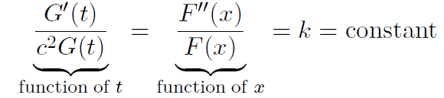



Solution by the method: separating variables (same as last lecture)
Assume the solution: $u\left(x,t\right)=F\left(x\right)G(t)$
Insert into the heat equation:
Left side:
Right side:
$$=$$
$$=$$
Then we get:
Dividing both sides by $c^{2}F\left(x\right)G\left(t\right):$

Slide 10
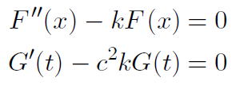
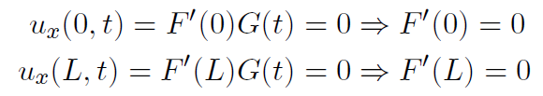
Solution by the method: separating variables
Now we have two ordinary diﬀerential equations (ODEs):
Boundary conditions:

Slide 11


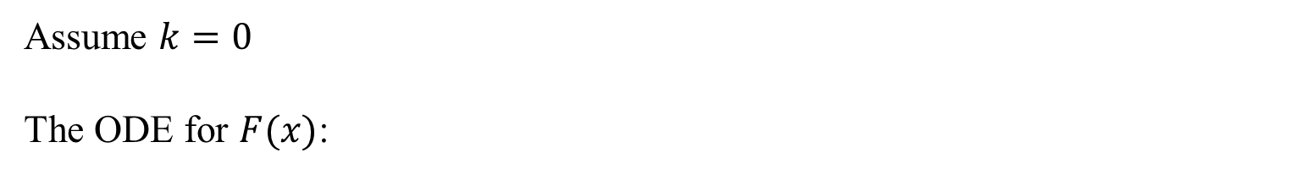
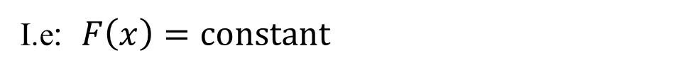

Solution by the method: separating variables
Assume $k=0$
The ODE for $F(x)$:
constants: a, b
$$F^{′}\left(x\right)=a$$
Boundary conditions:
$$F^{′}\left(0\right)=a=0⇒F\left(x\right)=b$$
$$F^{′}\left(L\right)=0$$
I.e: $F\left(x\right)=constant$
Interesting case

Slide 12

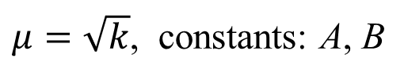
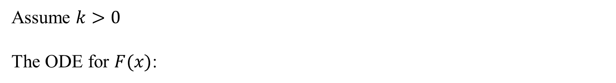
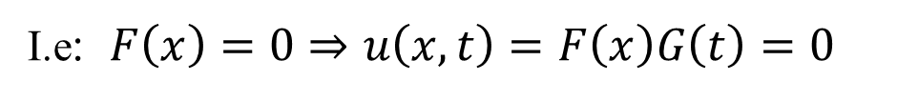
Solution by the method: separating variables
Assume $k>0$
The ODE for $F(x)$:
$μ=\sqrt{k}$, constants: A, B
Boundary conditions:
I.e: $F\left(x\right)=0⇒u\left(x,t\right)=F\left(x\right)G\left(t\right)=0$
Uninteresting case

Slide 13


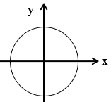


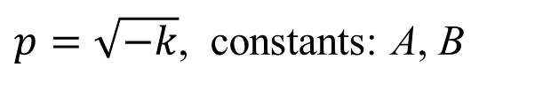
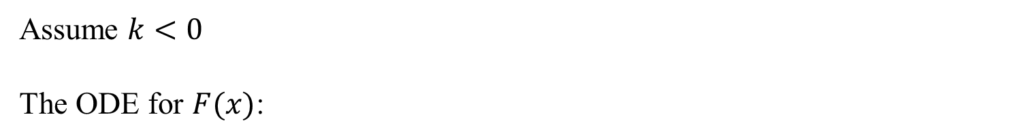
Solution by the method: separating variables
Assume $k<0$
The ODE for $F(x)$:
$$k=−p^{2}<0$$
$p=\sqrt{−k}$, constants: A, B
Boundary conditions:
This implies the condition:

Slide 14



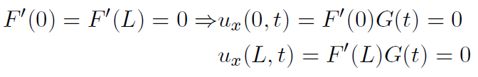
Solution by the method: separating variables
The spatial solutions:
Choose A = 1
Then we get the set of solutions:
The case where k = 0, choose the constant b = 1, and then
Together that gives:
which fulfil the boundary conditions:

Slide 15




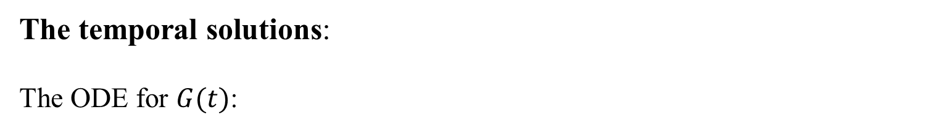

Solution by the method: separating variables (same as last lecture)
The temporal solutions:
The ODE for $G(t)$:
$$k=−p^{2}<0$$
Rewritten:
where:
The solutions:
$$B_{n}:arbitary constants$$

Slide 16




Solution by the method: separating variables
Fundamental solutions:
The solutions of the heat equation for n = 0,1, 2, 3, . . .
$$B_{n}:arbitary constants$$
and they fulfil the boundary conditions:
The exponential decay with rate:

Slide 17




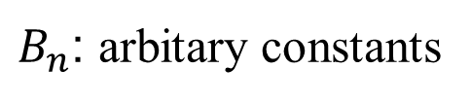

Solution by the method: separating variables
The heat equation is a homogeneous PDE:
According to the principle of superposition linear combination of solutions is also a solution
The general solution:
$$=$$
$B_{n}$: arbitary constants
fulfils boundary conditions:

Slide 18




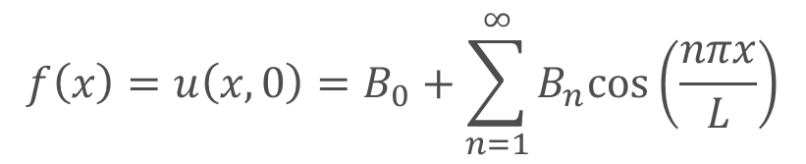
Solution by the method: separating variables
Using the initial condition the inﬁnitely many solutions are transformed into one, unique solution
$$f\left(x\right)=u\left(x,0\right)=B_{0}+\sum_{n=1}^{∞}{B_{n}cos\left(\frac{nπx}{L}\right)}$$
The initial temperature profile:
Fourier cosine series of the even expansion of the initial temperature proﬁle f(x), period p = 2L
Fourier coefficients:
Each initial temperature profile f(x), gives a uniquely determined set of constants $\left\{{B_{0},B}_{1},B_{2}, …\right\}$:
$$f(x)⇔\left\{{B_{0},B}_{1},B_{2}, …\right\}$$

Slide 19
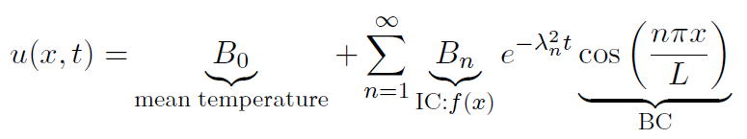
Solution by the method: separating variables
The unique solution:

Slide 20
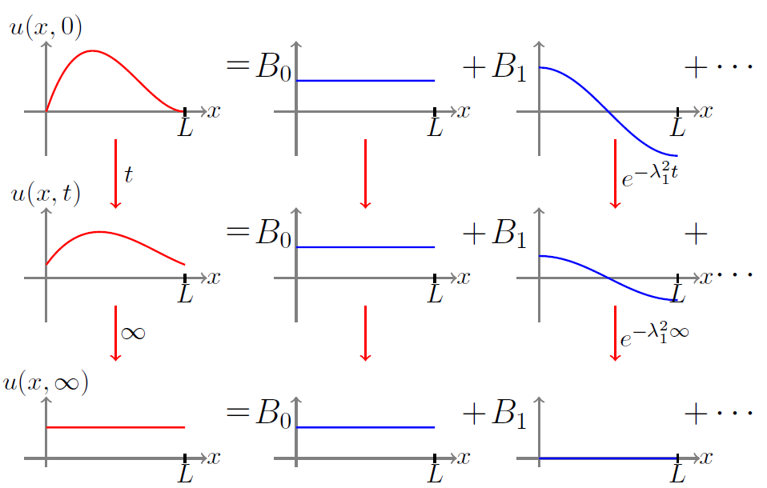

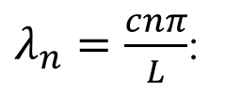
Heat equation – Second example
$λ_{n}=\frac{cnπ}{L}$:
J. Schmiegel: Lecture notes

Slide 21
Break

Slide 22

Heat equation – Two-dimensional
Given a very thin surface, S, which is insulated from above and below.
The two–dimensional heat equation for the temperature u(x, y, t) on the S:
We restrict the discussion to steady heat flow i.e. no time dependencies.
For steady heat flow the PDE for (the time-independent) temperature u(x,y):

Slide 23
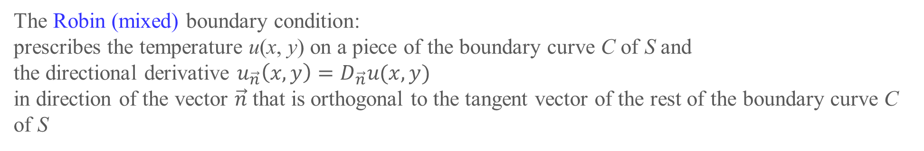
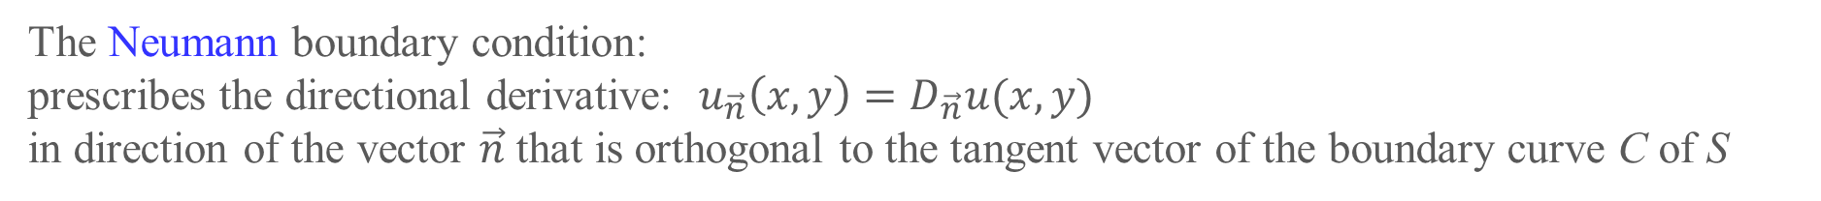
Three important cases of BC for the two dimensional steady heat flow
The Dirichlet boundary condition:
prescribes the temperature u(x, y) on the boundary curve C of S
The Neumann boundary condition:
prescribes the directional derivative: $u_{\vec{n}}\left(x,y\right)=D_{\vec{n}}u(x,y)$
in direction of the vector $\vec{n}$ that is orthogonal to the tangent vector of the boundary curve C of S
The Robin (mixed) boundary condition:
prescribes the temperature u(x, y) on a piece of the boundary curve C of S and
the directional derivative $u_{\vec{n}}\left(x,y\right)=D_{\vec{n}}u(x,y)$
in direction of the vector $\vec{n}$ that is orthogonal to the tangent vector of the rest of the boundary curve C of S

Slide 24
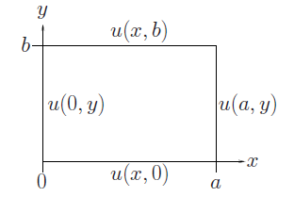
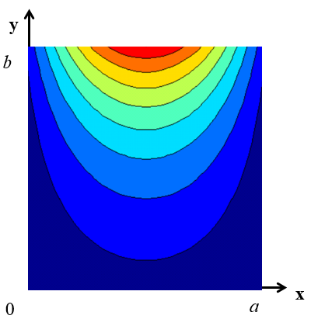
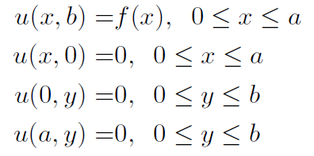
Heat equation – Two-dimensional
Consider a thin plate in the xy–plane with extension 0 ≤ x ≤ a, 0 ≤ y ≤ b .
The plate is insulated from above and below.
J. Schmiegel: Lecture notes
The Dirichlet boundary condition:

Slide 25

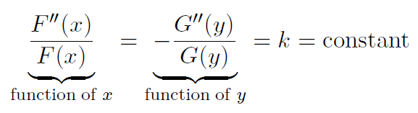


Solution by the method: separating variables
Assume the solution: $u\left(x,y\right)=F\left(x\right)G(y)$
Insert into the steady heat equation:
Then we get:
$$=0$$
Dividing both sides by $F\left(x\right)G\left(y\right):$

Slide 26
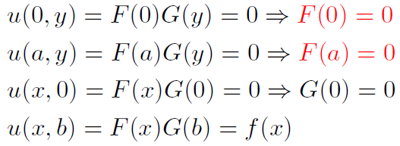
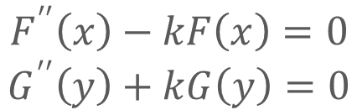
Solution by the method: separating variables
Now we have two ordinary diﬀerential equations (ODEs):
$$F^{′′}\left(x\right)−kF\left(x\right)=0$$
$$G^{′′}\left(y\right)+kG\left(y\right)=0$$
J. Schmiegel: Lecture notes
Boundary conditions:

Slide 27


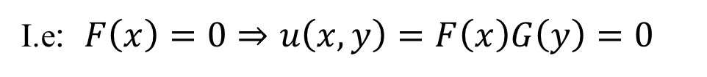
Solution by the method: separating variables
Assume $k=0$
The ODE for $F(x)$:
constants: c, d
Boundary conditions:
$$F(0)=d=0⇒d=0$$
$$F(a)=ca=0⇒c=0$$
I.e: $F\left(x\right)=0⇒u\left(x,y\right)=F\left(x\right)G\left(y\right)=0$
Uninteresting case

Slide 28


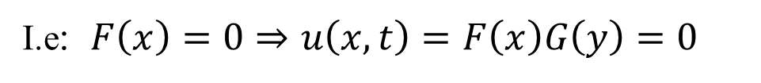
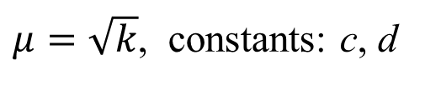
Solution by the method: separating variables
Assume $k>0$
The ODE for $F(x)$:
$μ=\sqrt{k}$, constants: c, d
Boundary conditions:
I.e: $F\left(x\right)=0⇒u\left(x,t\right)=F\left(x\right)G\left(y\right)=0$
Uninteresting case

Slide 29


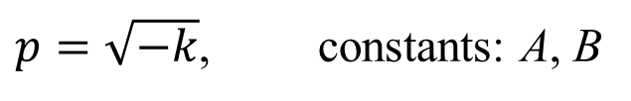

Solution by the method: separating variables
Assume $k<0$
The ODE for $F(x)$:
$$k=−p^{2}<0$$
$p=\sqrt{−k}$, constants: A, B
Boundary conditions:
This implies the condition:

Slide 30

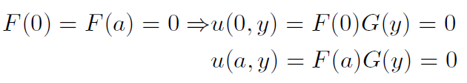
Solution by the method: separating variables
Solutions F:
Choose B = 1
Then we get the set of solutions:
which fulfil the boundary conditions:

Slide 31


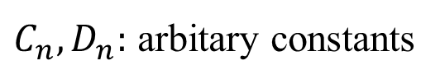
Solution by the method: separating variables
Solutions G:
The ODE for G(y):
$$k=−p^{2}<0$$
The solutions:
${C_{n},D}_{n}:$ arbitary constants
Boundary condition:

Slide 32

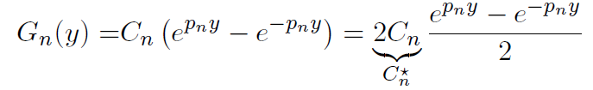


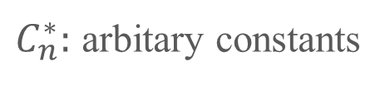

Solution by the method: separating variables
Solutions G:
Definition, hyperbolic sine function:
We rewrite the solutions:
$$=$$
, n = 1, 2, 3, ...
$C_{n}^{∗}:$ arbitary constants
which fulfil the boundary condition:

Slide 33

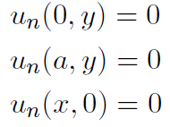
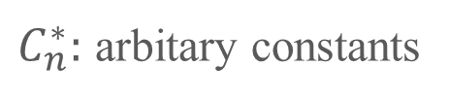
Solution by the method: separating variables
Fundamental solutions:
The solutions of the two dimensional steady heat equation for n = 1, 2, 3, . . .
$C_{n}^{∗}:$ arbitary constants
and they fulfil the boundary conditions:
The last upper boundary conditions: u(x,b) = f(x) is not yet used

Slide 34

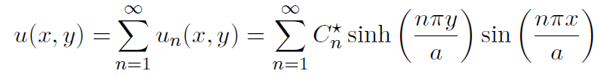


Steady heat equation – Two-dimensional
The steady heat equation is a homogeneous PDE:
According to the principle of superposition linear combination of solutions is also a solution
The general solution:
$C_{n}^{∗}:$ arbitary constants
fulfils boundary conditions:

Slide 35
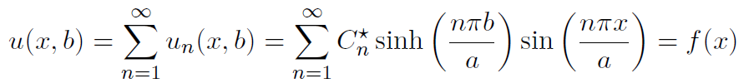



Heat equation – Two-dimensional
Using the upper boundary condition the inﬁnitely many solutions are transformed into one, unique solution
u(x,b) = f(x)
J. Schmiegel: Lecture notes
Fourier sine series of the odd expansion of f(x), period p = 2a
Fourier coefficients:
The constants:
Any given boundary condition f(x), gives a uniquely determined set of constants $\left\{C_{1}^{∗},C_{2}^{∗}, …\right\}$:
$$f(x)⇔\left\{C_{1}^{∗},C_{2}^{∗}, …\right\}$$

Slide 36
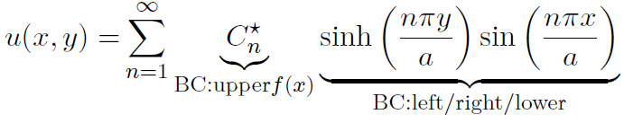
Heat equation – Two-dimensional
The unique solution:

Slide 37
We are doing exercises from lecture notes 10
In the exercise 1:
We have a wave equation. But we have not discussed these BC before, so we don’t know what the solutions are. Therefore you have to discuss different values of k.
In the exercise 2:
We have a steady heat flow, and we had just discussed the BC. So you don’t need to repeat all the discussions with k. Therefore you can just start with the generel solution.
In the exercise 3:
We have a steady heat flow. But we have not discussed these BC before, so we don’t know what the solutions are. Therefore you have to discuss different values of k.
Keep in mind:
Finding a Fourrier coefficient you don’t always have to calculate them, some times you can just read them off as we did in Lecture 7.
In the exercises the IC and BC are as simple as possible, so you don’t need to integrate.

Slide 38
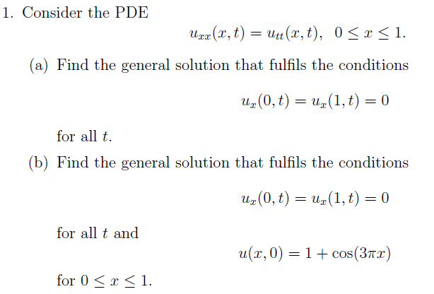
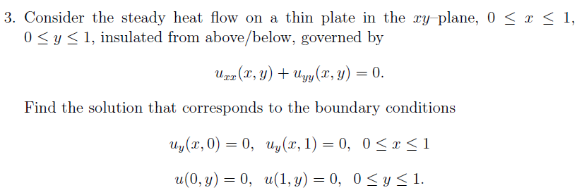
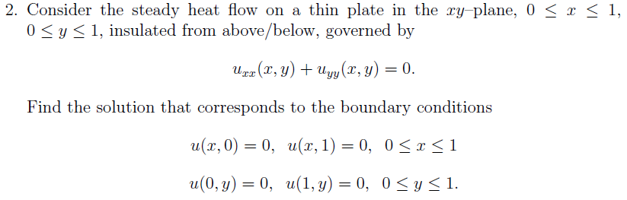
We are doing exercises from lecture notes 10

Slide 40



Solution by the method: separating variables
Reminder from previous courses:
The general solution of depends on k
For k = 0: arbitrary constants A, B
For k > 0: arbitrary constants A, B
For k < 0: arbitrary constants A, B

Slide 41
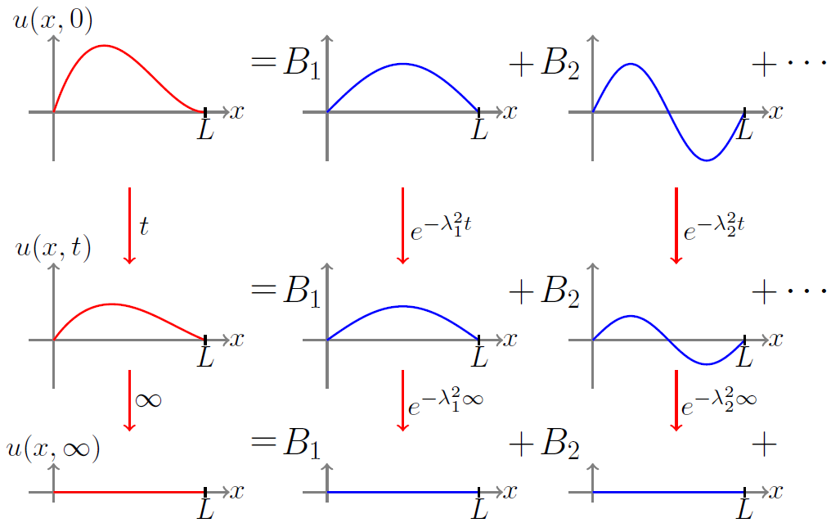
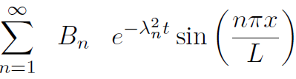
Heat equation – First example
$λ_{n}=\frac{cnπ}{L}$:
J. Schmiegel: Lecture notes

